Slide 1

A Hybrid Approach to Eliminate Rain or Snow from single color image PRESENTER : MUGDHA BHAGWAN CHINDHE (305030) GUIDE : PROF. G.G.CHIDDARWAR

Slide 2
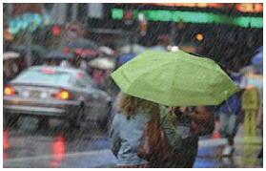
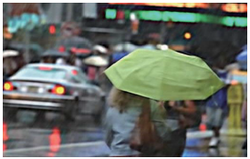
Objectives
To remove rain from image

Slide 3


Objective
To remove snow from image

Slide 4
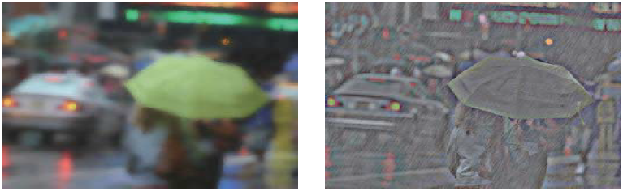
Property of rain/snow
Image decomposed into low-frequency and high-frequency part.
Low-frequency part is free of rain or snow.
High-frequency part contain rain or snow components.
I = IL + IH
Fig.- low-frequency part(IL) Fig.- high-frequency part(IH)

Slide 5
Can low-frequency part consider as a final result image ?
No, cannot consider it as final rain/snow removed image.
Because, low-frequency part image is blurred .
Some image details are still present in high-frequency part.
Solution :
Extract image details from high-frequency part and add it into low-frequency part.

Slide 6
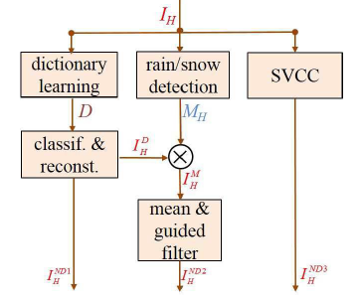
How to extract image details?
Dictionary learning
Detection of dynamic component
SVCC
Apply guided filter

Slide 7
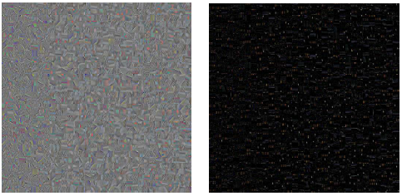
Dictionary learning
To extract image details from high-frequency part
Trained dictionary with 1024 atoms.
Dynamic components and non-dynamic components separated by dictionary atoms.
Some dictionary atom stand for dynamic and others for non-dynamic , for this three times classification of dictionary atom implemented.
Dig. Shows trained dictionaries for high-frequency part of rain image and snow image respectively.

Slide 8


Detection of dynamic components
Detect dynamic component
Apply guided filter
Hole appear at rain/snow location.
Fill hole by mean value of neighboring non-rain/snow pixel.
Fig.- Detection of rain Fig.-Detection of snow

Slide 9
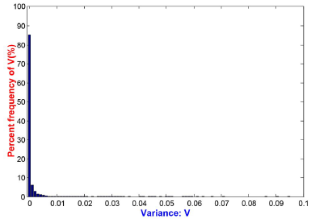
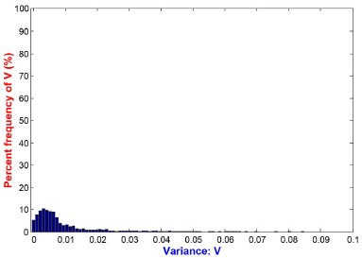
Property of rain/snow
Variance of rain/snow pixels is near to zero.
Variance of non-rain/snow pixels is in larger range.

Slide 10
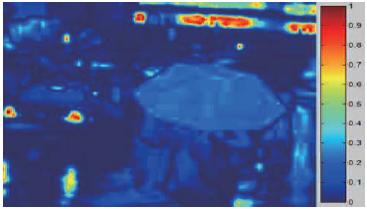
SVCC
Sensitivity of variance of color channel
Difference between dynamic component and other content of image.
Fig.- SVCC map of rain image

Slide 11
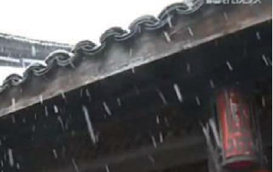
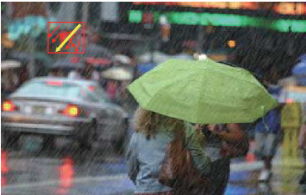
Property of rain/snow
Rain have same consistent falling direction.
Snow do not always have same consistent falling direction.

Slide 12
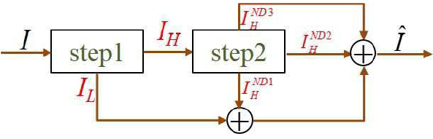
Methodology
Step 1:
1.1 Detection of dynamic componenets
1.2 Image decomposition
Step2 : 3-layer hierarchy
2.1 Layer-1 : Dictionary learning
2.2 Layer-2: Detection of dynamic
componenets and apply guided filter
2.3 Layer-3: SVCC map

Slide 13
Layer 1
Dictionary learning concept used.
Three times classification of high-frequency part image.

Slide 14
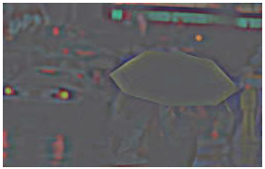
First Classification
Calculate sum of pixel color channel variance Sk
Threshold T1 is choose to identify dynamic components
If Sk < T1 , dictionary atom will be dynamic component ( ) otherwise non-dynamic component ( ).
Fig.- non-dynamic component ( )

Slide 15
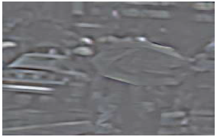
Second classification
Color values of extracted non-dynamic components are quite different from dynamic components .
Calculate average of absolute horizontal gradient of pixels in dictionary atoms.
Dynamic component denoted as and non-dynamic component denoted as .
Fig.- non-dynamic component ( )

Slide 16
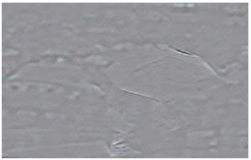
Third Classification
To extract non-dynamic details from .
calculate PDIP of dynamic atom.
Dynamic component denoted as and non-dynamic component denoted as .
Fig.- non-dynamic component( )

Slide 17

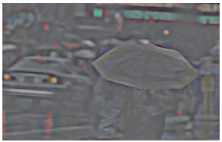
After three times classification , we obtain non-dynamic component and
dynamic component as follows:
= +
+

Slide 18

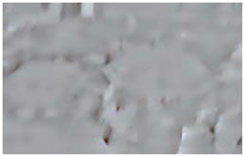
Layer-2
Some non-dynamic details still exist in dynamic component after third classification, so to extract it layer-2 is used.
Detection of dynamic component and apply guided filter, this two methods are used which are same as first step of algorithm.
At last , we get the non-dynamic part denoted as . .

Slide 19

Layer-3
After layer-1,2 rain/snow remove result are still little blurred.
SVCC map concept used .

Slide 20

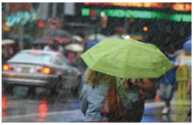
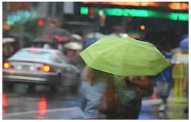
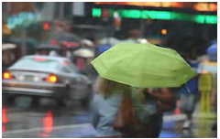
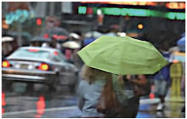

Result
At last , we sum up all non-dynamic components to obtain rain/snow removed image.
Î = , Î is the final result image.
I :input image Î : final result

Slide 21
Limitations
Still produces blurring when input image is of heavy rain.
Time complexity is more.

Slide 22
References
[1] Y. Wang,S. Liu,B. Zeng, "A Hierarchical Approach for Rain or Snow Removing in a Single Color Image," IEEE Trans.image processing., vol. 26, NO. 8, Aug. 2017, pp. 3936-3950.
[2] S. K. Nayar and S. G. Narasimhan, “Vision in bad weather,” in Proc. IEEE Conf. Comput. Vis., vol. 2. Sep. 1999, pp. 820–827.
[3] K. Garg and S. K. Nayar, “Detection and removal of rain from videos,” in Proc. IEEE Conf. Comput. Vis. Pattern Recognit. (CVPR), vol. 2.Washington, DC, USA, Jul. 2004, pp. 528–535.

Slide 23


